Slide 1
GCM/ProActive: a distributed component model, its implementation, and its formalisation
Ludovic Henrio
http://www-sop.inria.fr/oasis/Ludovic.Henrio/
OASIS Team
INRIA – UNS – I3S – CNRS
Sophia Antipolis

Slide 2




Our general approach
Programmingmodel and definitions
Implementation
Optimizations
Generic
properties
Verification and tools
Optimizations
Notes:
----- Notes de la réunion (7/16/12 11:21) -----
animer rouge et jaune

Slide 3
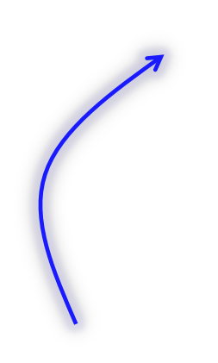


Our general approach
Programming
model and definitions
Implementation
Optimizations
Generic
properties
Verification tools
Optimizations
Definitions and Properties are easy to understand
definitions
properties
check the proofs

Slide 4
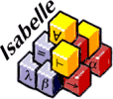
Our general approach
Programming
model and definitions
Implementation
Optimizations
Generic
properties
Verification tools
Optimizations
Definitions and Properties are easy to understand
definitions
properties

Slide 5
Agenda
A Distributed Component Model:
implementation and formalisation
Behavioural Specification
A Few Hot Topics

Slide 6
What are Components?
Primitive component
Business code
Client
/ output
Server
/ input

Slide 7

What are GCM Components?
Composite component
Primitive component
Primitive component
Business code
Business code
Grid Component Model (GCM)
An extension of Fractal for Distributed computing
Reference implementation: GCM/ProActive
based on the ProActive Java library

Slide 8
But what is a Good size for a
(primitive) Component?
Not a strict requirement, but somehow imposed by the model design
According to CCA or SCA, a service (a component contains a provided business function)
According to Fractal, a few objects
According to GCM, a process
In GCM/ProActive,
1 Component (data/code unit)
= 1 Active object (1 thread = unit of concurrency)
= 1 Location (unit of distribution)
GCM: A Grid Extension to Fractal for Autonomous Distributed Components - F. Baude, D. Caromel, C. Dalmasso, M. Danelutto, V. Getov, L. Henrio, C. Pérez - Annals of Telecom. - 2008

Slide 9
A Primitive GCM Component
CI
CI.foo(p)
In ProActive/GCM a primitive component is an active object
Primitive components communicating by asynchronous requests on interfaces
Components abstract away distribution and concurrency
Notes:
----- Notes de la réunion (7/16/12 11:21) -----
enlever requete1
1

Slide 10
Futures for Components
1
2
f=CI.foo(p)
……….
3
g=f+3
g=f+3
Component are independent entities
(threads are isolated in a component)
+
Asynchronous requests with results
⬇
Futures are necessary
Notes:
Ajouter 1 2 3

Slide 11
First-class Futures
…
…
…
Only strict operations are blocking (access to a future)
Communicating a future is not a strict operation
In ProActive and ASP, futures are created and accessed implicitly (no explicit type “future”)
IN contrast with Creol, Jcobox, ...
Last minute note: Any service policy (FIFO or FIFO filtered)
f=CI.foo(p)
CI.foo(f)
CI.foo(f)

Slide 12
First-class Futures and Hierarchy
return C1.foo(x)
… … …
Without first-class futures, one thread is systematically blocked in the composite component.
A lot of blocked threads
In GCM/ProActive ➔ systematic deadlock

Slide 13
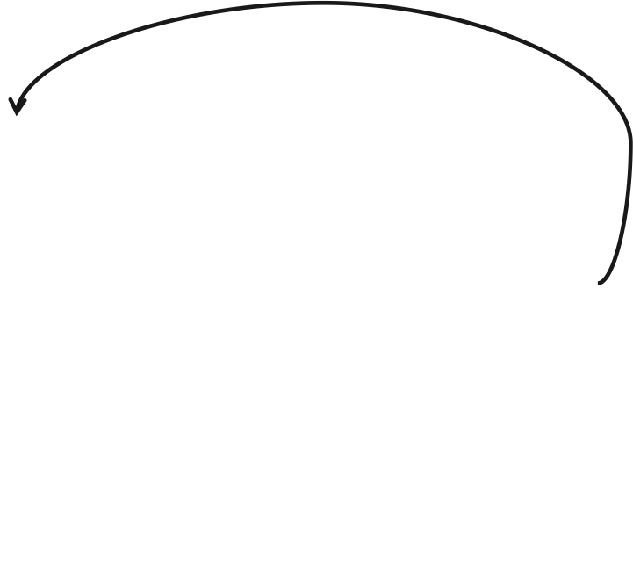
Future Update Strategies (Muhammad Khan)
How to bring future values to components that need them?
A “naive” approach: Any component can receive a value for a future reference it holds.
More operational is the lazy approach:
require future value

Slide 14
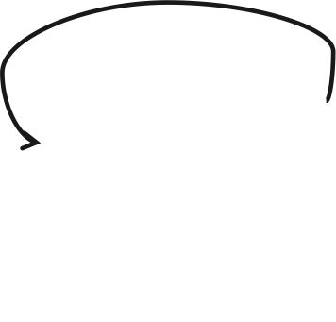
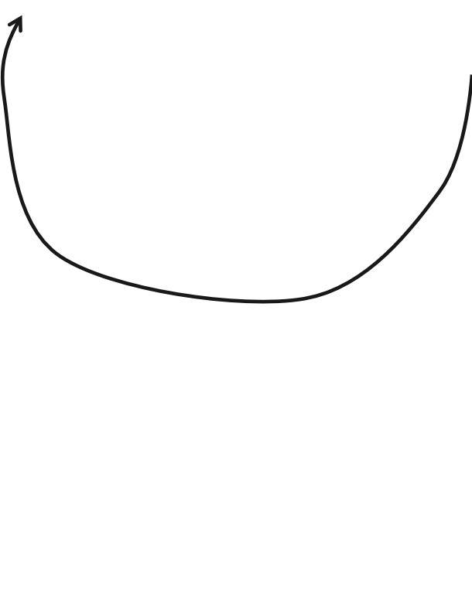
Eager home-based future update
avoids to store future values indefinitely
Relies on future registration
register future
Results sent as soon as available
Every component with future reference is registered
Un-necessary transfers
Garbage collection of computed results possible
Formalised in Isabelle
register future
First Class Futures: Specification and Implementation of Update Strategies
L. Henrio, Muhammad U. Khan, Nadia Ranaldo, Eugenio Zimeo CoreGRID@Europar 2010.

Slide 15
A Framework for Reasoning on Components in Isabelle/HOL
Formalise GCM in a theorem prover (Isabelle/HOL )
Component hierarchical Structure
Bindings, etc…
Design Choices
  Suitable abstraction level
  Suitable representation (List / Finite Set, etc …)
Basic lemmas on component structure
Semantics for primitive components (~LTS)
Delegation semantics for composites
Composite component
Primitive component
Business code
Primitive component
Business code
A Framework for Reasoning on Component Composition
Ludovic Henrio, Florian Kammüller, and Muhammad Uzair Khan - FMCO 2009, Springer

Slide 16
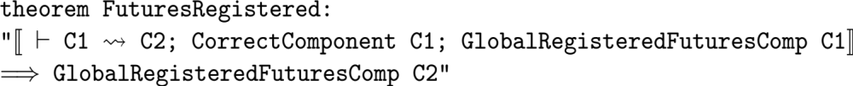
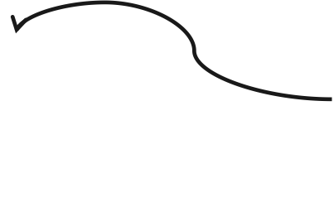
Properties on Future updates
Future updates remove all references to a given future
All Future references are registered during reduction
Garbage collectable
Complete
registration
register future
Ludovic Henrio and Muhammad Uzair Khan “Asynchronous Components with Futures: Semantics and Proofs in Isabelle/HOL” - FESCA 2010 - ENTCS

Slide 17
A refined GCM model in Isabelle/HOL
More precise than GCM, give a semantics to the model:
  asynchronous communications: future / requests
  request queues
  no shared memory between components
  notion of request service
More abstract than ProActive/GCM
  can be multithreaded
  no active object, not particularly object-oriented
A guide for implementing and proving properties of component middlewares
Similarities with: SCA and Fractal (structure),
Creol (futures)

Slide 18
Agenda
A Distributed Component Model:
implementation and formalisation
Behavioural Specification
A Few Hot Topics

Slide 19
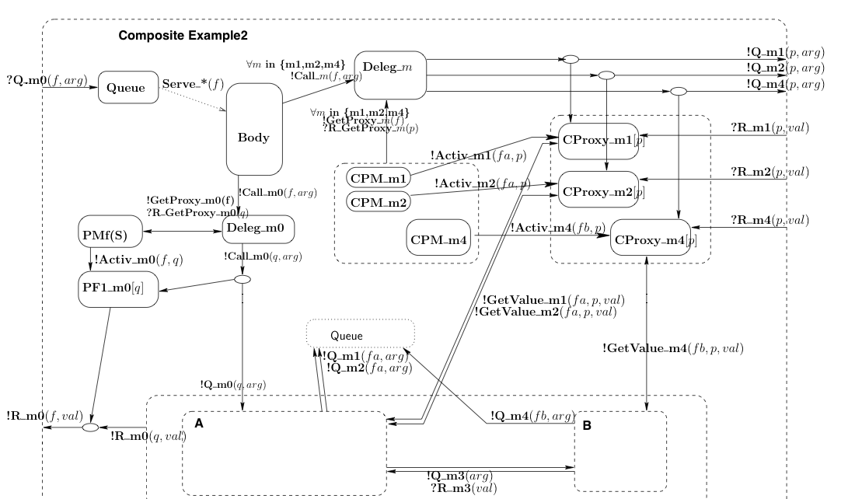
How to ensure the correct behaviour of a given program?
Theorem proving too complicated for the ProActive programmer
Our approach: behavioural specification
Service methods
Service methods
pNets:
Trust the implementation step
Or static analysis
Generate correct (skeletons of) components
(+static and/or runtime checks)
Behavioural Models for Distributed Fractal Components Antonio Cansado, Ludovic Henrio, and Eric Madelaine - Annals of Telecommunications - 2008

Slide 20
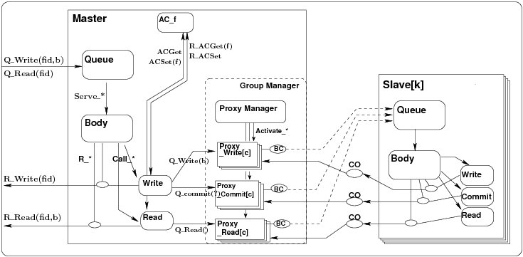
Full picture: a pNet
Support for parameterized
families
?Q_Write(x)
!Q_Write(b)
Syncronisation vectors

Slide 21
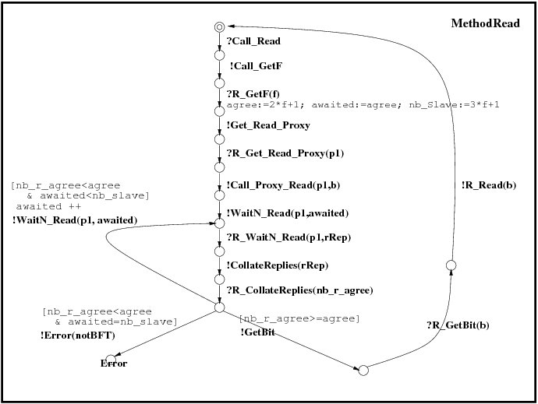
Basic pNets: parameterized LTS
Labelled transition systems, with:
Value passing
Local variables
Guards….
Can be written as a UML diagram
Eric MADELAINE

Slide 22
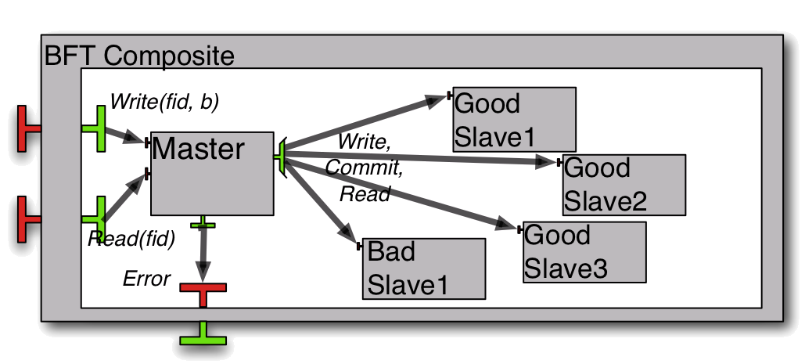
Use-case: Fault-tolerant storage
1 composite component with 2 external services Read/Write.
The service requests are delegated to the Master.
1 multicast interface sending write/read/commit requests to all slaves.
the slaves reply asynchronously, the master only needs enough coherent answers to terminate
Verifying Safety of Fault-Tolerant Distributed Components
Rabéa Ameur-Boulifa, Raluca Halalai, Ludovic Henrio, and Eric Madelaine - FACS 2011

Slide 23
Properties proved
Reachability(*):
1- The Read service can terminate
 fid:nat among {0...2}. ∃ b:bool. <true* . {!R_Read !fid !b}> true
2- Is the BFT hypothesis respected by the model ?
< true* . 'Error (NotBFT)'> true
Termination:
After receiving a Q_Write(f,x) request, it is (fairly) inevitable that the Write services terminates with a R_Write(f) answer, or an Error is raised.
Functional correctness:
After receiving a ?Q_Write(f1,x), and before the next ?Q_Write, a ?Q_Read requests raises a !R_Read(y) response, with y=x
(*) Model Checking Language (MCL), Mateescu et al, FM’08
Prove
generic properties like absence of deadlock
or properties specific to the application logic

Slide 24
Recent advances in behavioural specification for GCM
WCSI’10: group communication
FACS’11: GCM & multicast interfaces
Application to BFT
More to come ?
Reconfiguration...
FACS’08: 1st class futures
CoCoME: hier. & synch.
pNets: 2004-2008
Scaling-up : gained orders of magnitude by a combination of:
  data abstraction,
  compositional and contextual minimization,
  distributed state-space generation.
Specified formally the whole generation process (in progress)

Slide 25
Agenda
A Distributed Component Model:
implementation and formalisation
Behavioural Specification
A Few Hot Topics

Slide 26

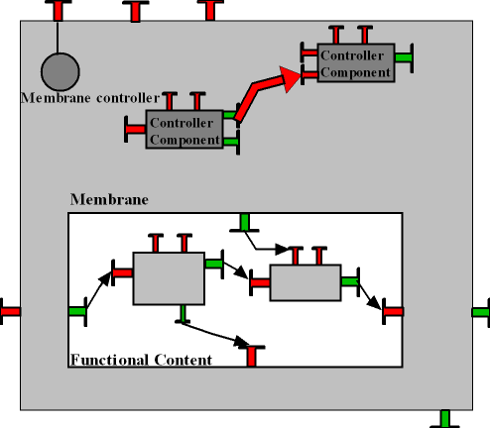
Adaptation in the GCM
Functional adaptation: adapt the architecture
+ behaviour of the application to new
requirements/objectives
Non-functional adaptation:
adapt the architecture of the container+middleware to changing environment/NF requirements (QoS …)
Additional support for reconfiguration:
A stopping algorithm for GCM
components
A Scripting language for reconfiguring
distributed components
Both functional and non-functional adaptation are expressed as reconfigurations
Language support for distributed reconfiguration:
GCM-script
A platform for designing and running autonomic components
A Component Platform for Experimenting with Autonomic Composition
Françoise Baude, Ludovic Henrio, and Paul Naoumenko. Autonomics 2007.

Slide 27
Formalising Reconfiguration (preliminary)
In our Isabelle/HOL model component structure known at runtime
  Two reconfiguration primitives formalised
  Basic proofs illustrate the feasibility of the approach
In our behavioural model
  Old results: start/stop/bind for Fractal components
  For GCM: formalisation and experiments in progress

Slide 28
Correct component reconfiguration
Towards safety and autonomicity
Verify reconfiguration
procedures
Safe adaptation procedures
for autonomic applications
Some directions:
  Parameterized topologies: ADL[N] ; behavioural specification (pNets) ; reconfiguration primitives
  Use of theorem proving + prove equivalence between the Isabelle GCM model and the behavioural specification
  ➔prove and use generic properties of
  reconfiguration procedures

Slide 29
Correct component reconfiguration
Towards safety and autonomicity
Verify reconfiguration
procedures
Safe adaptation procedures
for autonomic applications
Some directions:
  Parameterized topologies: ADL[N] ; behavioural specification (pNets) ; reconfiguration primitives
  Use of theorem proving + prove equivalence between the Isabelle GCM model and the behavioural specification
  ➔prove and use generic properties of
  reconfiguration procedures
[N]

Slide 30
Primitive Multi-Active GCM Component
join()
Provided add, add and monitor are compatible
add() {
CI.foo(p)
}
add() {
…
… }
monitor(){…
… }
Fewer deadlocks,
better adapted to multicore architectures
Compatibility is defined by annotations in the Java code

Slide 31
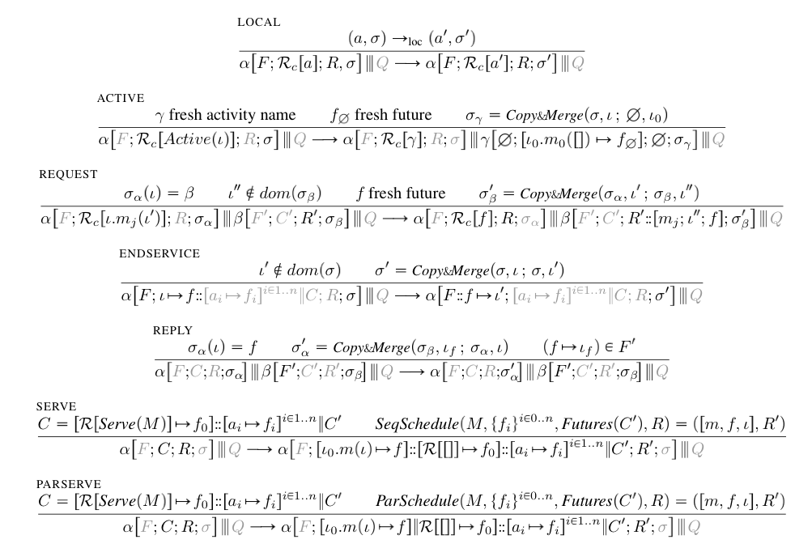
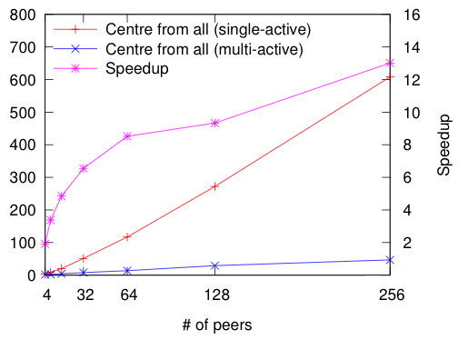
Results / Status
Implemented multi-active objects above ProActive
Added dynamic compatibility rules
Used on case studies (NAS, CAN)
Specified the semantics of Multi-ASP
Proved first properties, i.e., the semantics guarantees that two requests executed in parallel are compatible
Next steps:
  Publish the model
  Formalisation in Isabelle/HOL
  Use the new model
  Prove stronger properties (confluence?)
Conclusion: Active objects and components fit well together

Slide 32
Special thanks to …
Some of the people involved in this work
Marcela Rivera
Zsolt Istvan
Tomas Barros
Boutheina Bannour
Fabrice Huet
Muhammad Khan
Rabéa Boulifa
Antonio Cansado
Françoise Baude
Denis Caromel
Paul Naoumenko
Florian Kammueller
Eric Madelaine
CoreGrid partners
And others !!!

